Slide 4
Psalm 127:3 Children are a gift from the Lord; they are a reward from him. 4 Children born to a young man are like arrows in a warrior’s hands. 5 How joyful is the man whose quiver is full of them!

Slide 5
1.Parenting is a lifetime gig
2.Parenting at each stage has its challenges and joys

Slide 6
God as the perfect parent:
1. His patience and kindness never run out – Psalm 103:17 But the love of the Lord remains forever with those who fear him.

Slide 7
God as the perfect parent:
2. He is always approachable – Hebrew 4:16 So let us come boldly to the throne of our gracious God. There we will receive his mercy, and we will find grace to help us when we need it most.

Slide 8
3. God as the perfect parent:
His love is unconditional –
Romans 8:38-39 …indeed, nothing in all creation will ever be able to separate us from the love of God that is revealed in Christ Jesus our Lord.

Slide 9
God as the perfect parent:
4. He has our very best in mind –
John 10:10 My purpose is to give them a rich and satisfying life.

Slide 10
God as the perfect parent:
5. He loves us enough to discipline us –
Proverbs 3:12 the Lord disciplines those he loves, as a father the son he delights in.

Slide 11
God as the perfect parent:
6. He gives wisdom generously –
James 1:5 If you need wisdom, ask our generous God, and he will give it to you. He will not rebuke you for asking.

Slide 12
God as the perfect parent:
7. He lets us make our own choices –
Prodigal son (Luke 15: 11-32)

Slide 13
God as the perfect parent:
8. He knows us intimately –
Psalm 139 ‘O Lord, you have examined my heart and know everything about me…’

Slide 14
Isaiah 1:2-4 ‘This is what the Lord says: “The children I raised and cared for have rebelled against me. Even an ox knows its owner and a donkey recognises its master’s care— but Israel doesn’t know its master. My people don’t recognise my care for them.’

Slide 15
Some parenting foundations

Slide 16
Genesis 2: 24 This explains why a man leaves his father and mother and is joined to his wife, and the two are united into one.

Slide 17
Parenting:
Balance of warmth and firmness
4 parenting styles

Slide 19
Neglectful

Slide 20
Authoritarian

Slide 21
Indulgent

Slide 22
Authoritative

Slide 23
Discipline:
the practice of training people to obey rules or a code of behaviour, using punishment to correct disobedience.

Slide 24
Proverbs 13:24
Those who spare the rod of discipline hate their children. Those who love their children care enough to discipline them.

Slide 25
Proverbs 19:18
Discipline your children while there is hope. Otherwise you will ruin their lives.

Slide 26
Proverbs 29:
15 To discipline a child produces wisdom, but a mother is disgraced by an undisciplined child.
17 Discipline your children, and they will give you peace of mind and will make your heart glad.

Slide 27
Ephesians 6: 4
Fathers, do not provoke your children to anger by the way you treat them. Rather, bring them up with the discipline and instruction that comes from the Lord.

Slide 28
Parenting traps to avoid:
You are not your child’s best friend!

Slide 29
Parenting traps to avoid:
You are not your child’s best friend!
Helicopter parenting

Slide 30
Parenting traps to avoid:
You are not your child’s best friend!
Helicopter parenting
Lawnmower parenting

Slide 31
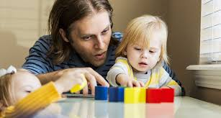
Ages and stages:
0-3 years

Slide 32
Ages and stages:
4-8 years

Slide 33
Ages and stages:
9-12 years

Slide 34
Ages and stages:
Adolesence

Slide 35
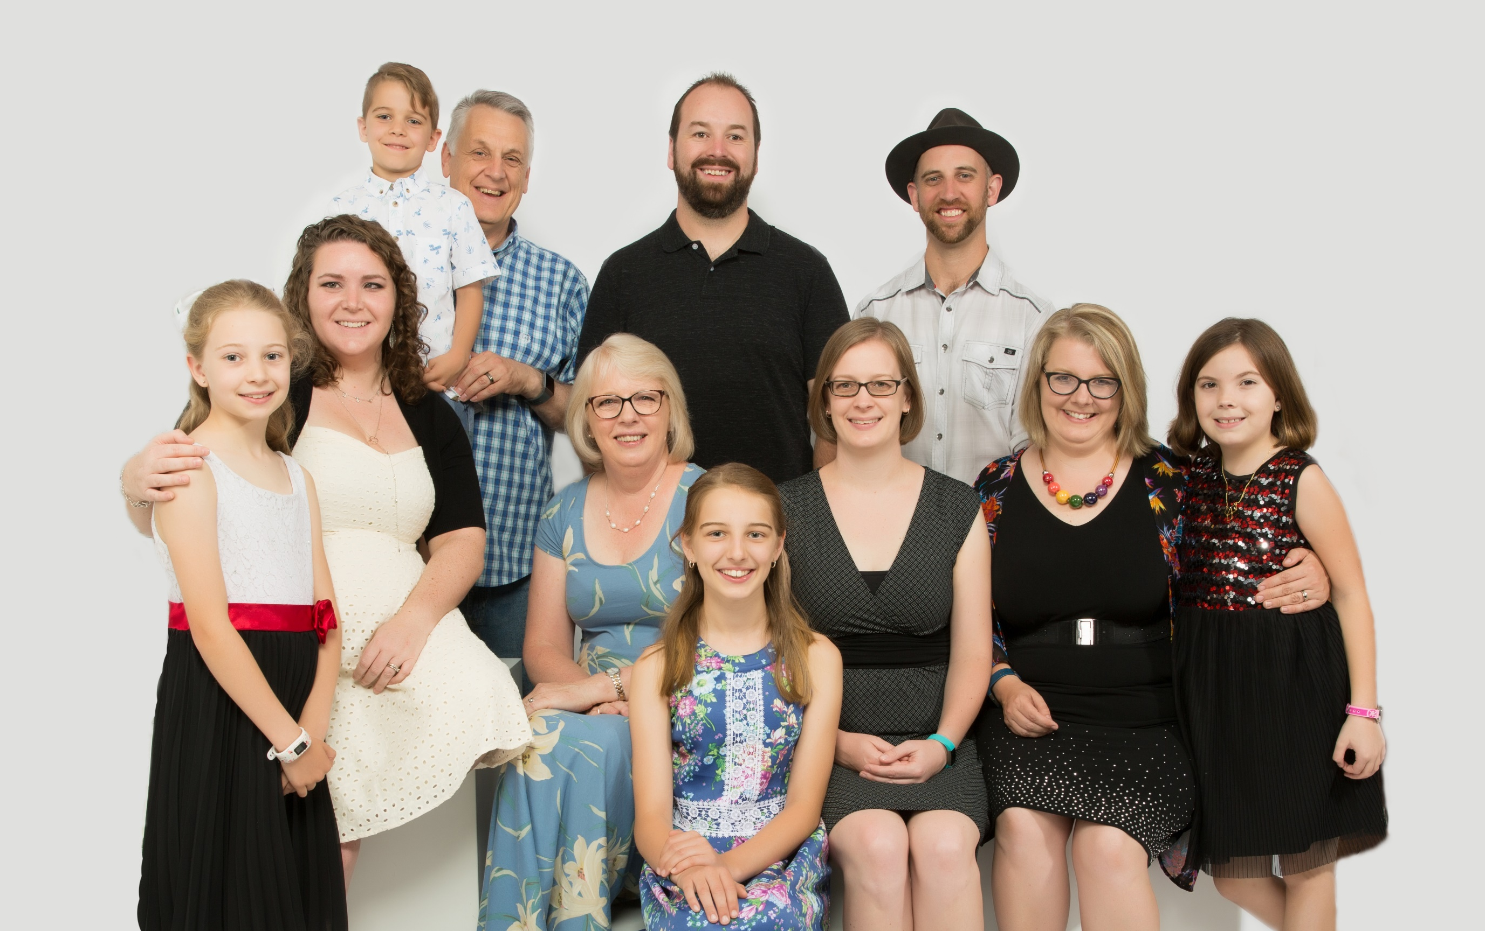
Ages and stages:
Adult children

Slide 36
Proverbs 17: 6
Grandchildren are the crowning glory of the aged

Slide 37
Parenting adult children:
Be available but set boundaries

Slide 38
Parenting adult children:
Be available but set boundaries
Share your wisdom and insight

Slide 39
Parenting adult children:
Be available but set boundaries
Share your wisdom and insight
Embrace their new ‘normal’

Slide 40
Parenting adult children:
Be available but set boundaries
Share your wisdom and insight
Embrace their new ‘normal’
Prepare them for hardship

Slide 41
Parenting adult children:
Be available but set boundaries
Share your wisdom and insight
Embrace their new ‘normal’
Prepare them for hardship
Pray continually

Slide 42
Parenting adult children:
Recognise and respect your differences
Share your wisdom and insight
Be available but set boundaries
Prepare them for hardship
Embrace their new normal
Pray continually
Entrust them to God

Slide 43
Proverbs 22:6
Direct your children onto the right path, and when they are older, they will not leave it.

Slide 44
Deuteronomy 6:6 And you must commit yourselves wholeheartedly to these commands that I am giving you today. 7 Repeat them again and again to your children. Talk about them when you are at home and when you are on the road,

Slide 45
when you are going to bed and when you are getting up. 8 Tie them to your hands and wear them on your forehead as reminders. 9 Write them on the doorposts of your house and on your gates.

Slide 46
Psalm 76:
We will not hide these truths from our children; we will tell the next generation about the glorious deeds of the Lord…So each generation should set its hope anew on God.

